Slide 1
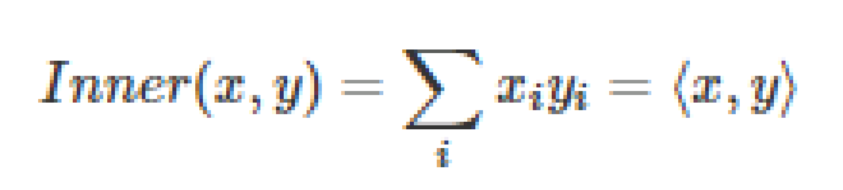
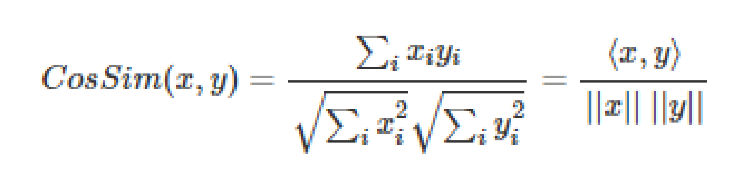
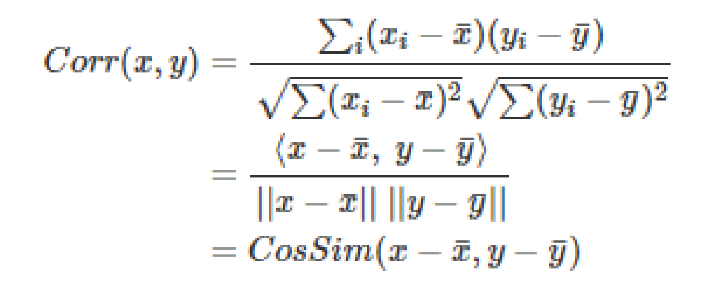
Fundamental concepts of similarity
Euclidean Distance
Cosine Similarity:
Cosine Similarity is the cosine of the angle between the 2 vectors A and B
Closer the vectors, smaller will be the angle and hence larger their cosine value.
Pearson Similarity:
Pearson similarity is also another measure of finding similarity between two vectors.
Pearson correlation and cosine similarity are invariant to scaling.
Cosine similarity is NOT invariant to shifts. Pearson correlation is invariant to shifts.
Correlation is the cosine similarity between centered versions of x and y & between -1 to 1

Slide 2
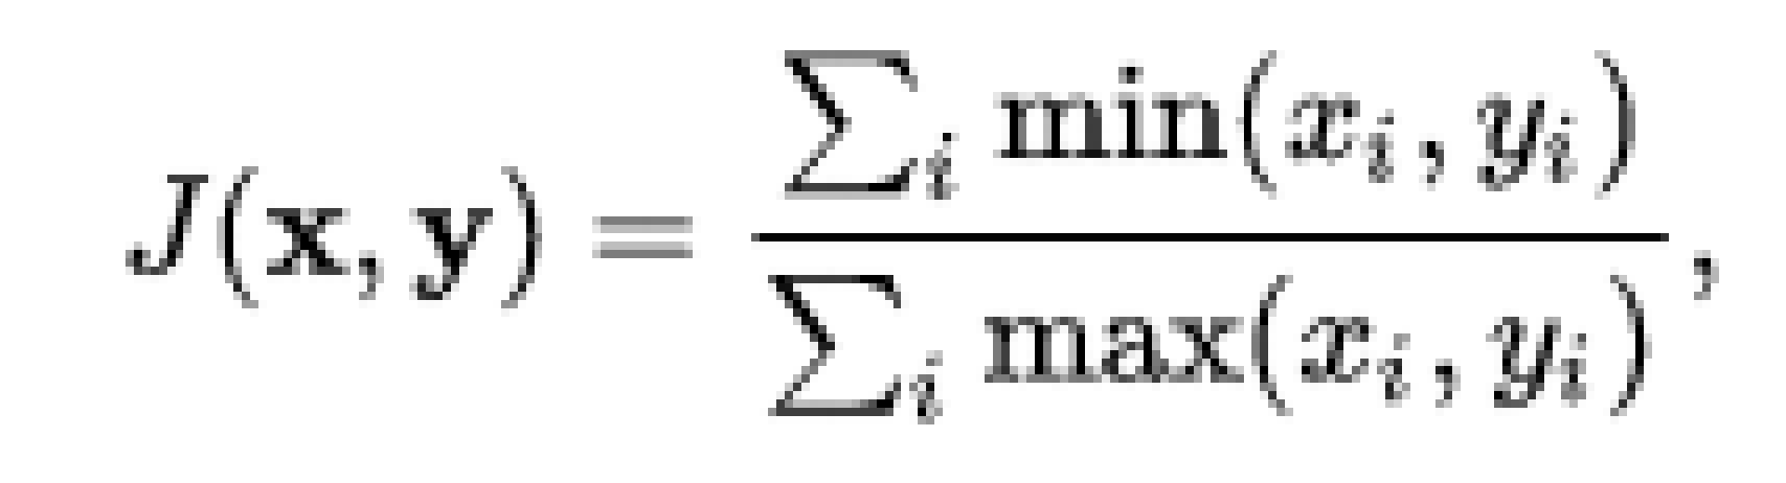
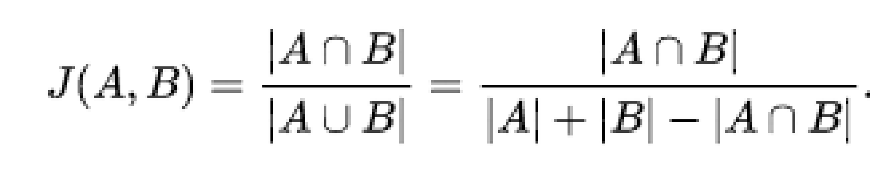
Fundamentals
Jaccard Similarity:
Similarity is defined as the number of users which have rated item A and B divided by the number of users who have rated either A or B
Intersection over Union
It is used for comparing both similarity and diversity of two sets
If x,y are two vectors with all real xi, yi then jaccardian similarity coefficient:
The Jaccard distance, which measures dissimilarity between sample sets, is complementary to the Jaccard coefficient and is obtained by subtracting the Jaccard coefficient from 1

Slide 3
Collaborative Filtering
Idea: If a person X likes items A, B, C and Y like B,C,D then they have similar interests and X should like item D and Y should like item A.
This algorithm is entirely based on the user’s past behaviour and not on the context.
This makes it one of the most commonly used algorithm and is not dependent on any additional information.
Basic assumptions:
Customers who had similar tastes in the past, will have similar tastes in the future
Users give ratings to catalog items (implicitly or explicitly)
Examples:
Product recommendations by e-commerce player like Amazon and merchant recommendations by banks like American Express.
User-User Collaborative filtering
Item-Item Collaborative filtering

Slide 4
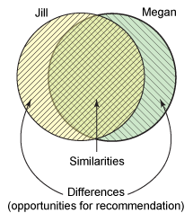
Collaborative Filtering
Recommend this difference to Megan
Recommend this difference to Jill

Slide 5
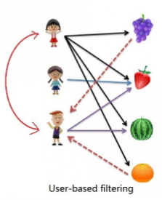
User based nearest neighbour Collaborative filtering
Find out the users who have a similar taste of products as the current user chosen.
Similarity is based upon similarity in their purchasing behaviour.
“User A is similar to user B because both purchased items x, y and z.”
Memory-based: the rating matrix is directly used to find neighbours / make predictions
Does not scale well for most real-world scenarios
Source: http://www.salemmarafi.com/code/collaborative-filtering-with-python/

Slide 6
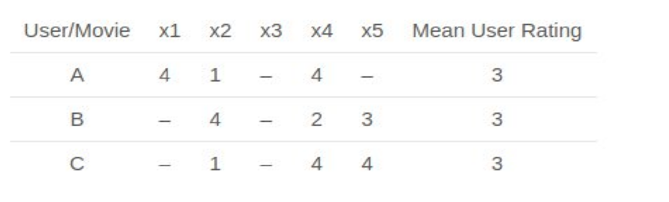
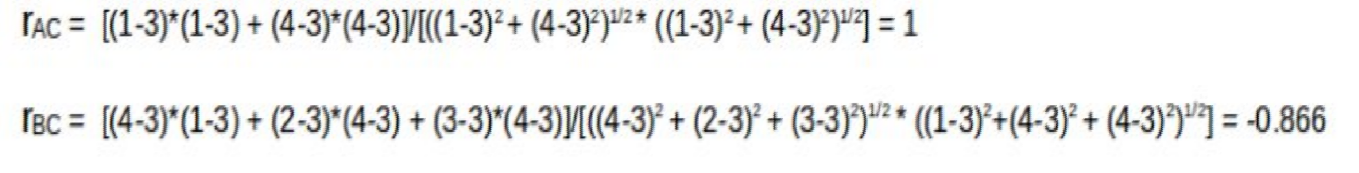
User-User collaborative filtering

Slide 7
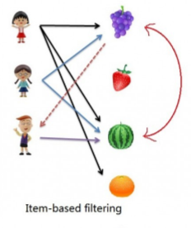
Item based nearest-neighbour collaborative filtering
Reverse of user based collaborative filtering
Recommend items to the user that are similar to the items the user has bought.
Similarity is based upon co-occurence of purchases:
Use the similarity between items (and not users) to make predictions
“Items x and y were purchased by both users A and B, so they are similar.”
Item-based CF is an example for model-based approaches
Source: http://www.salemmarafi.com/code/collaborative-filtering-with-python/

Slide 8
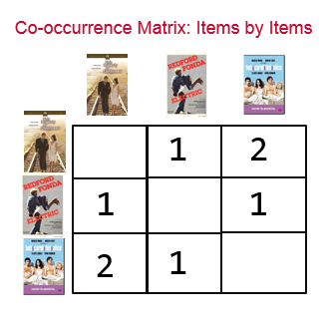
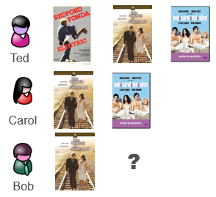
Item based collaborative filtering: Example
History Matrix
B
A
C
A
B
C
A
C
A
B
A
C
Bob’s Recommendations= [C, B]
Source: https://www.mapr.com/blog/inside-look-at-components-of-recommendation-engine

Slide 9
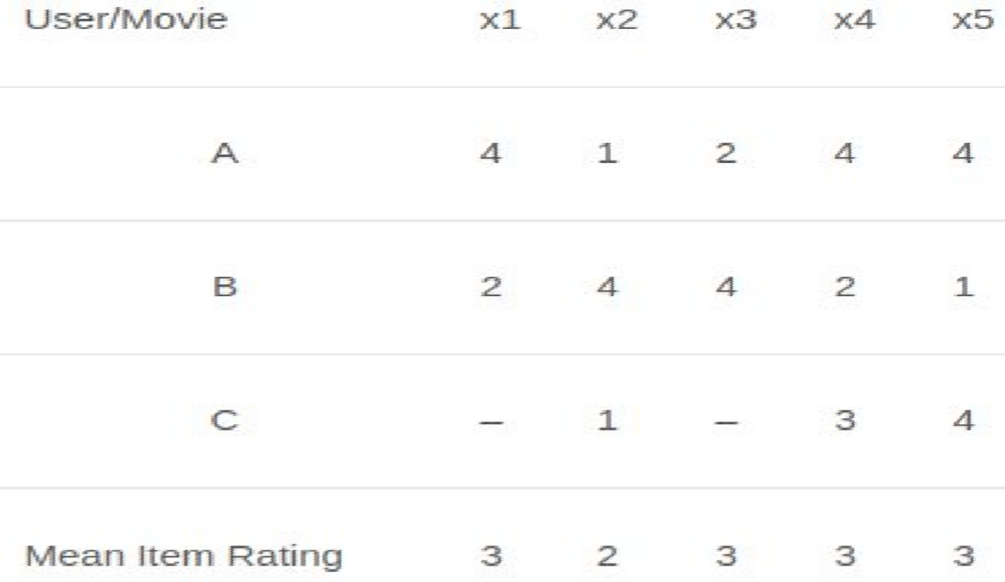
Item-Item collaborative filtering

Slide 10
Collaborative filtering: Complexity
Expensive step:
Finding k most similar users or items O (|U|) where U is the size of utility matrix
Item -> compute similarity wrt every other item
Better not to do at run time
Can we precompute?
Simple pre-computation for ‘n’ items: O(n.|U|)
Techniques like dimensionality reduction or clustering or near neighborhood search algorithms can be used.

Slide 11
Strengths of Collaborative Filtering
Content-Agnostic
Does not require items or users to be tagged with content information
Recommendations are very personalized because they’re based on like-minded people
Adaptive to the user base
Can pick up on fitting recommendations that would be difficult or impossible to identify with a content-based method
Inherently adaptive to preference changes over time

Slide 12
Issues with collaborative filtering
Cold Start: There needs to be enough other users already in the system to find a match.
In recommender systems, the cold start problem is often reduced by adopting a hybrid approach between content-based matching and collaborative filtering.
Sparsity: If there are many items to be recommended, even if there are many users, the user/ratings matrix is sparse, and it is hard to find users that have rated the same items.
Systems unable to compute ratings for a large number of items since very few user preferences available
Unable to find similarities between users due to sparse representation available
Hybrid approaches help where content on users/items is used to improve predictions
Grey Sheep
Users for whom recommendations can not be made because of sparsity problem

Slide 13
Issues with collaborative filtering
Popularity Bias: Cannot recommend items to someone with unique tastes.
Tends to recommend only the popular items.
Recommender systems may only recommend popular items due to more data being available on them and may introduce a positive feedback loop not allowing more relevant items with less popularity
•Shilling attacks
Users creating fake preferences to push their own items
•Scalability
Collaborative filtering can be very computationally expensive
Distributed frameworks have been heavily used with organizations like Amazon, Facebook and LinkedIn developing their own engineering solutions to handle this

Slide 14
Comparision of methods for songs
A typical FM station creates a list of recommended songs by observing what bands and individual tracks the user has listened to on a regular basis and comparing those against the listening behaviour of other users.
The recommender plays tracks that do not appear in the user's library, but are often played by other users with similar interests.
This is an example of collaborative filtering
This requires a large amount of information about a user to make accurate recommendations. This is an example of the cold start problem, and is common in collaborative filtering systems.
An interesting approach is to use the properties of a song or artist (a subset of the 400 attributes provided by the Music Genome Project) to seed a "station" that plays music with similar properties.
User feedback is used to refine the station's results, deemphasizing certain attributes when a user "dislikes" a particular song and emphasizing other attributes when a user "likes" a song.
This is an example of a content-based approach.
The recommender needs very little information to start but is far more limited in scope

Slide 15
Market basket analysis
Discovers co-occurrence relationships among activities performed.
Market basket analysis can be used to divide customers into groups
Market basket analysis may provide the retailer with information to understand the purchase behavior of a buyer.
“customers who bought book A also bought book B”
When one super market chain discovered in its analysis that male customers that bought diapers often bought beer as well, have put the diapers close to beer coolers, and their sales increased dramatically.
Might tell a retailer that customers often purchase shampoo and conditioner together, so putting both items on promotion at the same time would not create a significant increase in revenue, while a promotion involving just one of the items would likely drive sales of the other.

Slide 16
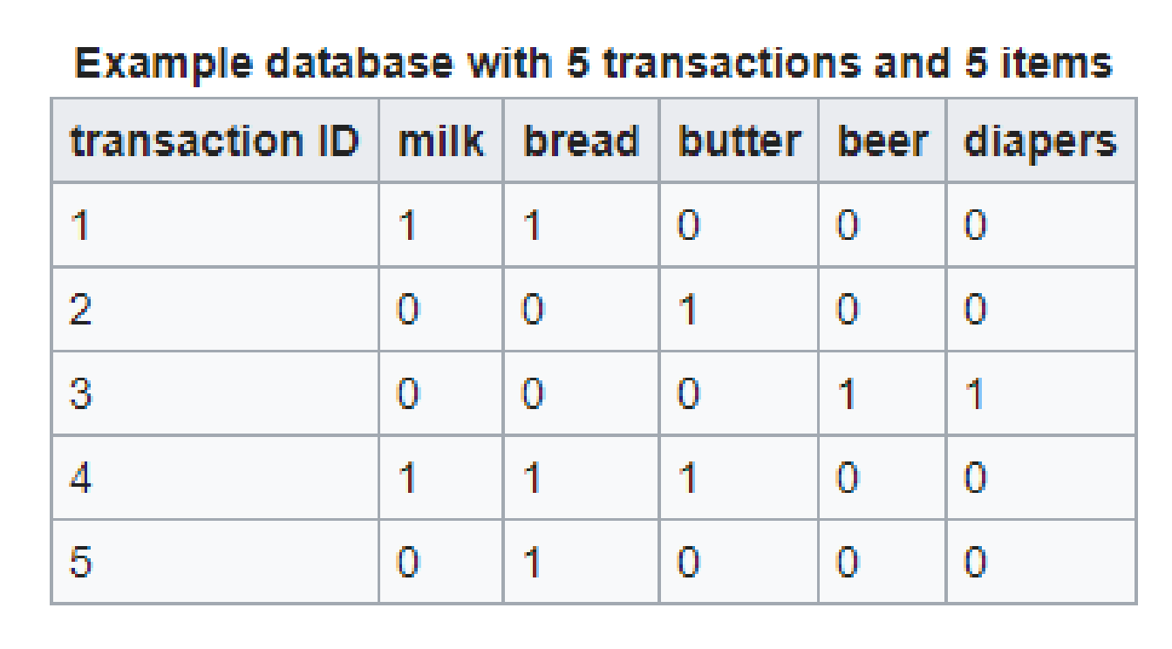

Association rule mining
Rules of the form x -> Y
from a set of sale transactions.
It's common use in shopping behaviour analysis
Can be used as the basis for decisions about marketing activities such as, e.g., promotional pricing or product placements.
It is NOT sequence mining: Association rule learning typically does not consider the order of items either within a transaction or across transactions.
Notes:
Make recommendations for Alice
Determine "relevant" rules based on Alice's transactions (the above rule will be relevant as Alice bought Item1)
Determine items not already bought by Alice
Sort the items based on the rules' confidence values

Slide 17
Performance metrics
RMSE
MAE –Mean Absolute Error
Accuracy
ROC curve
Precision
Recall
Precision Recall Curve: Evaluation of top n recommendations

Slide 18
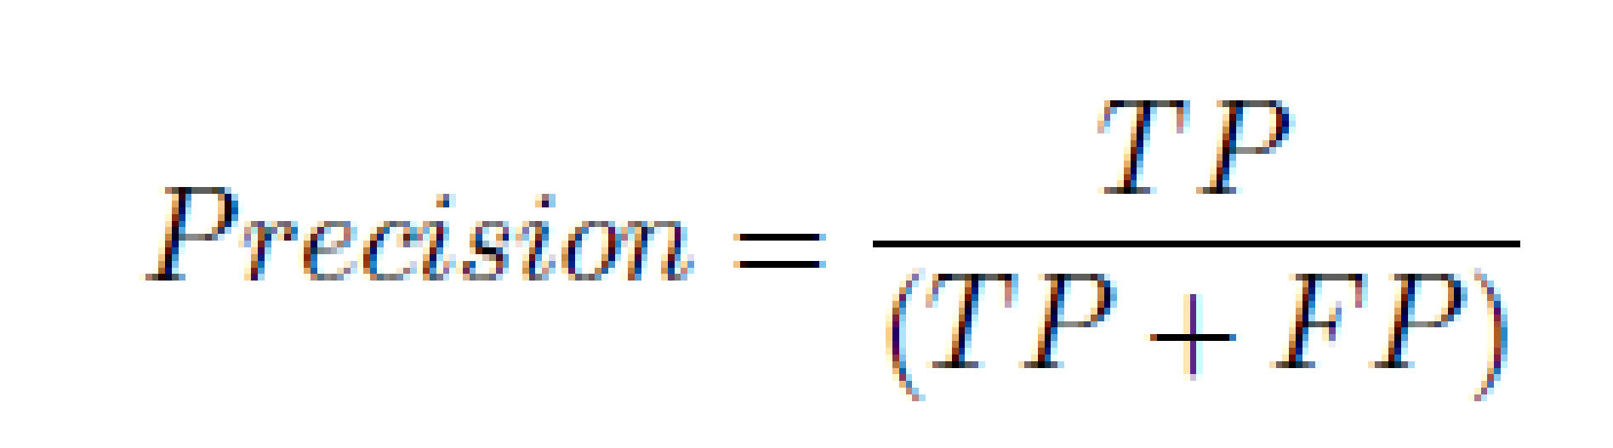
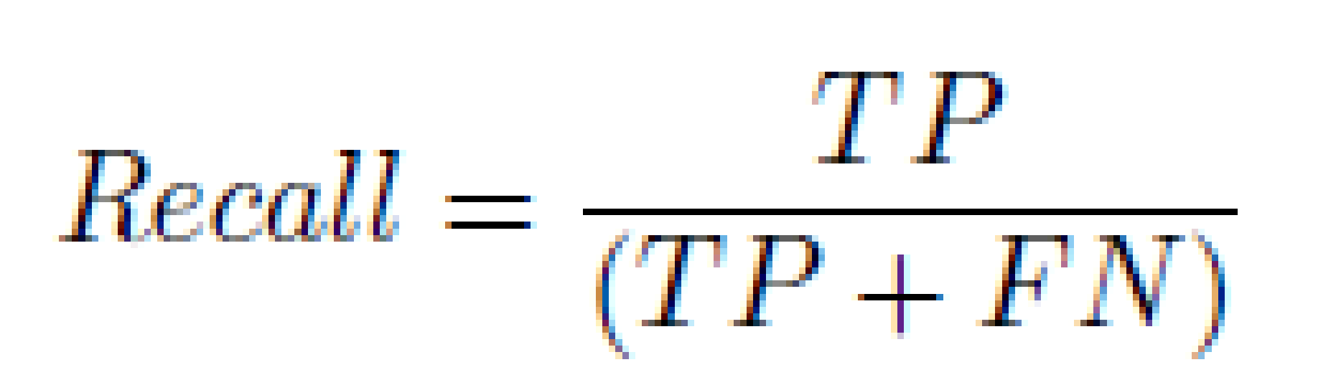
Evaluation measures
Out of all the recommended items, how many user actually liked the recommendations?
What ratio of items that a user likes were actually recommended.
Precision: Out of all items retrieved, how many are relevant
It is based on true positives and false positives.
It shows how many selected items are actually also relevant.
True positives (TP) are the positive guesses made that were actually correct while the false positives (FP) are the positive guesses made that were incorrect.
Recall: How many relevant items retrieved from all relevant items
is based on true positives and false negatives.
It shows how many of the relevant information is selected.
The true positives (TP) are again the positive guesses made that were actually correct while the false negatives (FN) are negative guesses while they should have been positive.

Slide 19
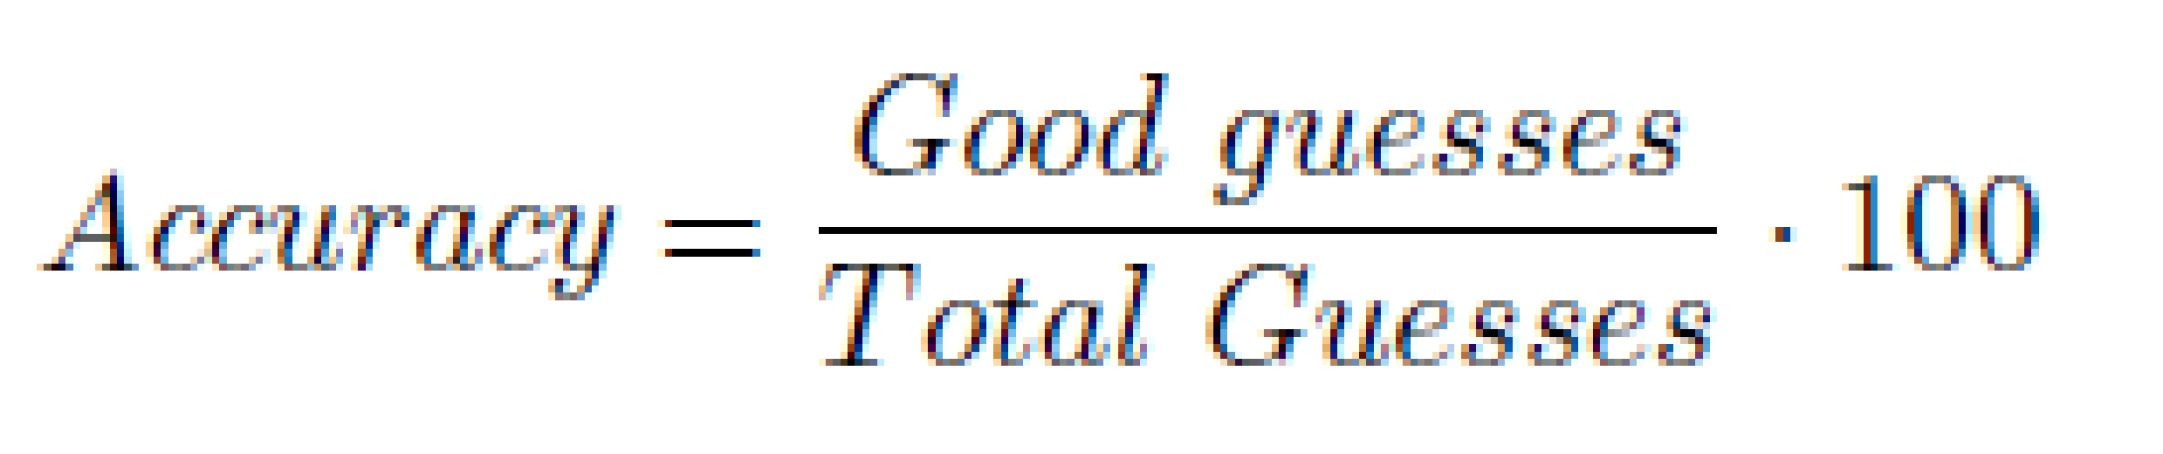
Evaluation measures
Accuracy: Percentage guessed correct from total guesses
method that is based on exact matches.
This is the most simple evaluation method, but may perform poorly based on the data.
If the labels of your data mostly consist of one specific cluster, the classifiers may classify all the data as that cluster. Since the data contains mostly that cluster, its accuracy will be high due to one classification.
This may cause promising results, but they are not correct. So for this measure, it is necessary to have information about the labels of your data. The number itself is not enough for performance conclusions.

Slide 20
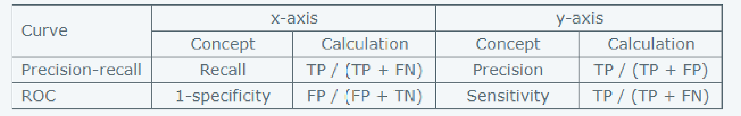
RoC and Precision Recall curve
Receiver operating characteristics curve.
A plot of true positive fraction (= sensitivity) vs. false positive fraction (= 1 – specificity) for all potential cut-offs for a test.
A ROC curve plots recall (true positive rate) against fallout (false positive rate) for increasing recommendation set size.
In Top-20 recommender example,
The 20 items you recommend for a user are the Positive items, and the unrecommended items are Negative.
Precision Recall Curve:
A precision-recall curve shows the relationship between precision (= positive predictive value) and recall (= sensitivity) for every possible cut-off.
The main difference between ROC curves and precision-recall curves is that the number of true-negative results is not used for making a PRC.

Slide 21
Hybrid recommender systems
Multiple recommender systems are combined to improve recommendations
•Although any type of recommender systems can be combined a common approach in industry is to combine content based approaches and collaborative filtering approaches
•Content based models can be used to solve the Cold Start and Gray Sheep problems in Collaborative Filtering
•Some of the typical methods of Hybridization include
Weighted –Recommendations from each system is weighted to calculate final recommendation
Switching –System switches between different recommendation model
Mixed - Recommendations from different recommenders are presented together
A common approach is to use Latent Factor models for high level recommendation and then improving them using content based systems by using information on users or items

Slide 22
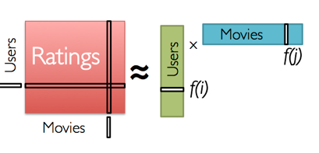
Model based collaborative filtering
Identify latent (hidden) features from the input user x item
Ratings matrix to represent users and items as vectors in N dimensional space.
Matrix factorization
Generate low-rank approximation of matrix
Detection of latent factors
Projecting items and users in the same n-dimensional space
Use Matrix factorization approaches (Eg. Singular value Decomposition or SVD) to split the Rating Matrix into constituent User Matrix and Item Matrix with minimum Sum of squared error (SSE).
SVD:
A_{nxp}= U_{nxn} S_{nxp} V^{T}_{pxp}
Goal: Predict unknown ratings for the remaining set of movies using the learned User Matrix and Item Matrix

Slide 23
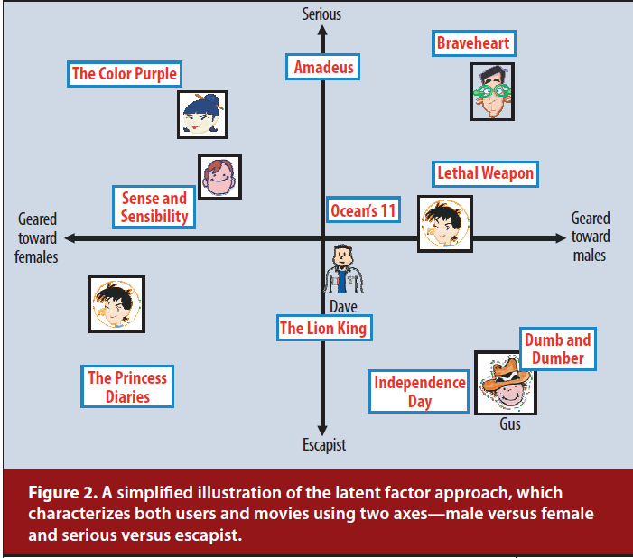
Identify hidden features from the input user x item ratings matrix to represent user and items as vector in N dimensional space
Source: IEEE - Matrix Factorization Techniques for Recommender Systems by Robert Bell, Yehuda Koren, Chris Volinskyy

Slide 24
Summary
Basics of recommendation system
Popularity based recommendations
Classification model based
Content based recommendations
Nearest neighbour collaborative filtering:
User based
Item based
Hybrid approches
Python examples
Association rule mining

Slide 25
Industry example of e-commerce
Events:-
Tracks and stores on all consumer activity and behavior
Each click on product, adding to wishlist, adding to cart, save for later and purchase
Ratings:-
Assign implicit values on user actions
Ratings of products from the users
And Feedback
Filtering:-
Hybrid approach of Collaborative filtering and user based filtering

Slide 26
Considerations
Sometimes not recommending or simple recommendation is the best option
Privacy concerns in Recommendation systems
The case of Target Corporation
Computational challenges in recommendation systems, can be costly to implement
•The final model built by winning Netflix team could not be implemented due to engineering challenges
•Good Data Collection, well thought out metrics are a must

Slide 27
References
1. http://dataconomy.com/an-introduction-to-recommendation-engines/
2. https://goo.gl/ehBnhf
3. https://github.com/dvysardana/RecommenderSystems_PyData_2016
4. https://brenocon.com/blog/2012/03/cosine-similarity-pearson-correlation-and-ols-coefficients/
5. https://wiki.epfl.ch/edicpublic/documents/Candidacy%20exam/Evaluation.pdf
6. http://www.quuxlabs.com/blog/2010/09/matrix-factorization-a-simple-tutorial-and-implementation-in-python/
7. Gunawardana, Asela, and Guy Shani. "A survey of accuracy evaluation metrics of recommendation tasks." Journal of Machine Learning Research10.Dec (2009): 2935-2962.
8. Davis, Jesse, and Mark Goadrich. "The relationship between Precision-Recall and ROC curves." Proceedings of the 23rd international conference on Machine learning. ACM, 2006.

Slide 28
Further reading
Book: Recommender Systems An Introduction by Dietmar Jannach
Book: Mining Massive Datasets by Jure Leskovec, Anand Rajaraman, Jeff Ullman (www.mmds.org)
Coursera course on Recommender Systems, by University of Washington
Coursera course on Recommender Systems, by University of Minnesota
https://dl.acm.org/citation.cfm?doid=2959100.2959166

